Slide 1
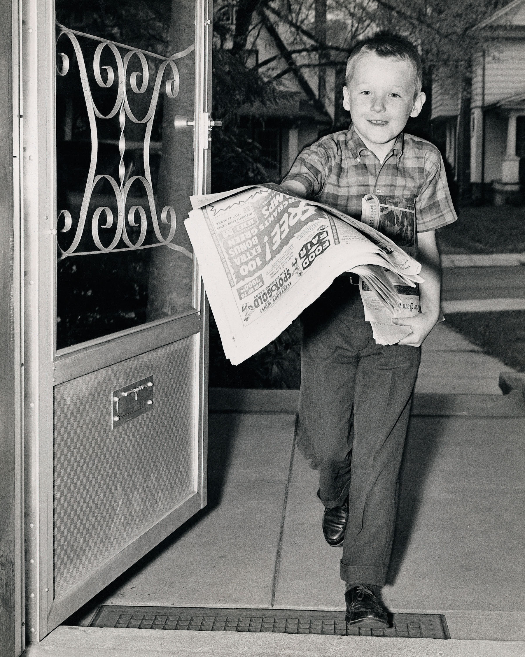
Catholic News
Archive
COALITION FOR NETWORKED INFORMATION
PROJECT BRIEFING – November 13, 2020

Slide 2
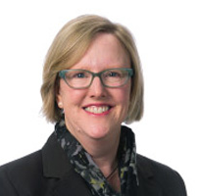
The Presenters
Paul Bracke
Jean McManus
DEAN
FOLEY LIBRARY
Gonzaga University
LIBRARIAN FOR CATHOLIC STUDIES AND
ARCHIVES ENGAGEMENT
University Archives, University of Notre Dame
Jennifer Younger
EXECUTIVE DIRECTOR
Catholic Research Resources Alliance
CO-AUTHOR
Notes:
Thanks for joining us this afternoon. I’m Paul Bracke, Dean of the Foley Library at Gonzaga University and Vice-Chair of the Board of the Catholic Research Resources Alliance.
My co-presenter is Jean McManus, Librarian for Catholic Studies and Archives Engagement at the University of Notre Dame, and we’re excited to share the work of the Catholic Research Resources Alliance on the Catholic News Archives today. We’d also like to acknowledge the contributions of Jennifer Younger, Executive Director of CRRA, in developing this presentation.

Slide 3
Catholic Research Resources Alliance
Mission
Provide enduring global access to Catholic research resources.
Independent 501c3
What We Do
Catholic Portal:
vufind.catholicresearch.org
Research guides:
guides.catholicresearch.org
Online resources on subjects related to Catholic studies.
Catholic News Archive:
thecatholicnewsarchive.org
Resource sharing:
www.catholicresearch.org/resource-sharing-forum
50 Members and Partners
Academic libraries: Notre Dame, Gonzaga, etc.
Religious congregation and diocesan archives.
Notes:
Just to start with a little bit of background, the Catholic News Archive is a program of the Catholic Research Resources Alliance, CRRA.
CRRA is an independent, membership organization that seeks to provide global access to Catholic research resources.
We have 50 members and partners. Many of these are academic libraries like Notre Dame, Gonzaga, Marquette, and University of San Diego. Our membership, however, also includes religious congregation and diocesan archives such as the Archdiocese of Cincinnati, the Catholic Historical Research Center of the Archdiocese of Philadelphia, and the Daughters of Charity Provincial Archives.
This work is done through a number of programs, including the Catholic Portal, which provides discovery to rare and difficult to locate Catholic research resources from across the Alliance’s Memberships.
Another major initiative is the one we’re here to share today, the Catholic News Archive.

Slide 4
Catholic News Archive
Unique digital collection of North American Catholic newspapers
Over half a million pages from 17 papers
Robust searching, easy browsing, mobile-friendly
75,000 users projected in 2020
Freely available to users
Notes:
The Archive opened in Sept. 2016 when other digital newspaper collections had been up and running for a decade or more. However, the need was clear. Catholic papers were underrepresented in other collections for a variety of reasons. There was little commercial market or candidly, not much demand outside of a small group of scholars of American Catholicism. Catholic newspapers are not widely collected by academic libraries and where they were collected, they weren’t high in the priorities for digitizing. State collections generally pursued representation from the major city and county papers in the state as the highest priority. Although as digitization expands, more religious papers are, or may be targets for addition to other collections, the papers in the Catholic News Archive are not today available in other in Chronicling America, the state collections or subscription-based publisher collections. The Catholic News Archive fills a gap in the landscape of digital newspaper collections.
The Catholic News Archive is a unique digital collection of North American Catholic newspapers that is freely available to users, currently consisting of over 500,000 pages from 17 papers. The 17 papers cover a range of dates, geography, and communities. Jean will discuss the research value of the collections in a little bit, but just to give you a few examples of newspapers in the collection, we have:
The Shepherd of the Valley was the first newspaper of the Archdiocese of St. Louis, published from 1832 to 1836 and was an English- and French-language newspaper.
The Catholic Worker was a newspaper started by Dorothy Day to make people aware of Catholic perspectives of social justice, including a strictly pacifist stance on World War II
La Esperanza was a national Catholic Spanish-language publication in Los Angeles, California. Sponsored by the Claretians, the weekly magazine began in 1929 and ended in 1955. It focused on Catholic topics relevant to the United States Spanish-speaking population, with a particular focus on the Mexican-American community.
Scanning and conversion meet or exceed the NDNP - National Digital Newspaper Program, with article and page level indexing done in METS/ALTO schema, widely used for newspapers in US and around the world.
Platform services are provided by Veridian, a New Zealand company. Mobile-friendly, platform used by many state level digital newspaper archives and national libraries.

Slide 5
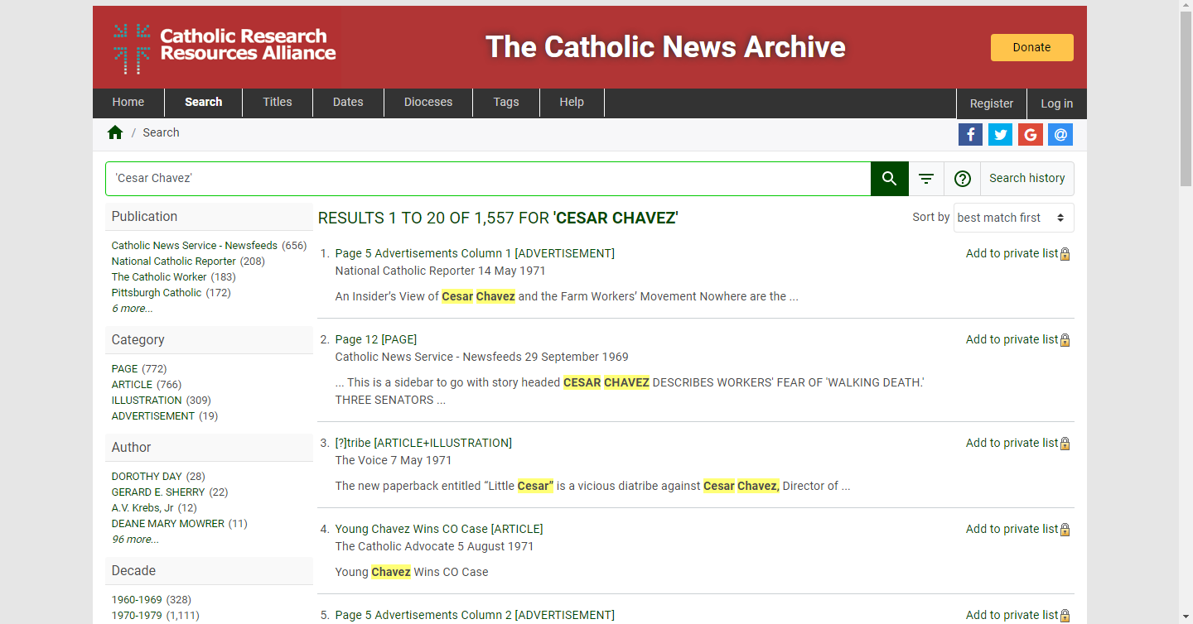

Slide 6
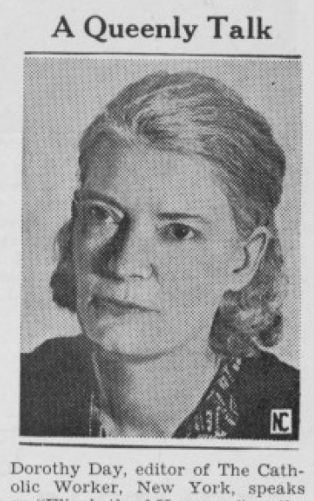
Development strategies
The Catholic World in Pictures, 13 April 1940
Designed for research
Ensure institutions with limited resources can participate
Online access in perpetuity
Partnerships for permissions, content, governance, funding
Open access (CC-BY-NC)
Inclusion of diverse Catholic voices: Clergy, Lay, Migrant, Black and Socialist communities
Contribute to the common good
Collection management
Notes:
While the content is clearly important, so is the business model we are building. From the beginning, we identified development and partnership strategies to guide the effort, which I’ll describe in short order.
I’ll start by highlighting a few of the Archives' strategies for development:
First, the archive has been guided from the beginning with a concern for functionality and access for researchers.
Second, the goal of the archive is to provide long-term, barrier-free access to the collection, calling only for users to attribute the source and make only non-commercial use of the content. Commercial reuse could be made with permission of the copyright owner and the publishers themselves could make commercial use of their content. In some cases, the newspapers digitized for the publisher through other commercial projects (for example, package deals that digitized the newspaper and sacramental records) might be made available through commercial platforms first followed after a set time period by freely available access to the digitize newspaper through the Catholic News Archive).
Third, a goal of the project has been to allow the participation of wide-range of participants in the project in a variety of roles. This includes participation from small academic libraries who might not otherwise have the resources or opportunity to participate in large-scale digitization projects, but also other types of institutions that may not always be included in these initiatives as partners with academic libraries. Among CRRA’s partners are diocesan archives, the Catholic Communication Campaign of the US Conference of Catholic Bishops, and a community of women religious.
I really can’t stress enough the importance of partnerships to the Archive and would also like to describe some of our approaches to developing them.

Slide 7
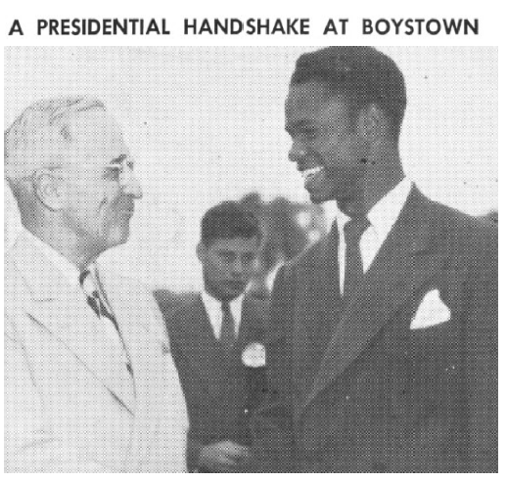
Partnership strategies
Permissions: Newspaper publishers
Content: Cultural heritage (diocesan archives), libraries
Governance: CRRA members (vote) and partner (advice)
Funding Founding institutions and grants
Together creating a common good
The Catholic World in Pictures, 11 June 1948
Notes:
The Catholic Newspaper Archive could not exist without partners, and we have engaged in a variety of strategies to develop partnerships for the initiative, both within the Catholic Research Resources Alliance and beyond the organization. These partnerships have enabled the work of the Archive on multiple fronts.
First, as mentioned earlier, a goal of the Archive is to make digitized content freely available to users and this certainly would not be possible without the newspapers with which we have partnered. We are ambitious in wanting content in the public domain but also 20th and 21st centuries content, which meant getting permissions from publishers and their approval of the Archive as an aggregated digital collection and repository.
These newspapers own the copyright and have granted the Catholic News Archive permission to make their content freely available online in perpetuity. In fact, openness has been a selling point to our partners for whom a primary concern has been expanding their own communities of readers, as well as their interest in contributing to the scholarly community writ large. We were able to partner with them in a manner that allows for open access to their papers while reserving to the publishers the right to approve, or not, commercial use by users as well as to make their own commercial reuse of their content. For some of our publishing partners, it may not be an either/or proposition as to whether to engage in commercial or open approaches for access to their content but rather a proposition in which they can leverage their commercial digitization activities to be able to contribute scans to the Catholic News Archive.
Second, we need partnerships to get access to copies of newspapers for digitization. Nationally, there are only a handful of collections of Catholic newspapers with a hundred titles or more – ND, Marquette, Catholic University of America, Georgetown, Wisconsin Historical Society, NYPL, and Library of Congress, not all of which are actively collecting at this time. We work with academic library partners for copies of national papers, such as The Catholic Worker, and with Atla for the master negative film of La Esperanza, published by a religious communities. Other Catholic universities may have some papers, perhaps a national paper, the local diocesan paper as well as a paper or two from their region although retention may be limited duration. In addition to the large academic collectors, we work extensively with diocesan archives who provide print or film copies of their papers for digitizing. A few examples are Philadelphia, Newark, Cincinnati, St. Louis. We do not require either the newspapers or the diocesan archives to join CRRA to participate.
Third, CRRA members and partners govern the Catholic News Archive, setting overall directions and policies through the Board of Directors. We actively solicit the input of newspapers and diocesan archives through the Digitizing Partners Forum which is then used in the big picture of directions and policies but just as importantly, in ongoing activities of seeking new titles and partners, promoting the Archive and improving the website presentation. This has been guided by a number of coordinating and advisory groups, including the Scholars Advisory Committee and the Newspapers Committee.
Finally, it is through partnerships that the initiative has been funded. In 2016, 26 founding institutions invested in the Vatican II Project which enabled us to set up the Archive and add some content for “proof of concept.” Since then, CRRA has received grants that funded the digitization as well as some of the publishing and archiving costs. Some of our partners obtained their own grants to digitize local newspapers (Cincinnati, Hartford, Philadelphia, Newark in progress) or internal funds (St. Louis, Notre Dame). CRRA continues to seek grants to digitize additional content and provides core operating support annually.
It is these layers of partnership that have allowed us to work together toward a common good.
With that, I’ll hand things over to Jean to discuss the value of the collections in the Archive.

Slide 8
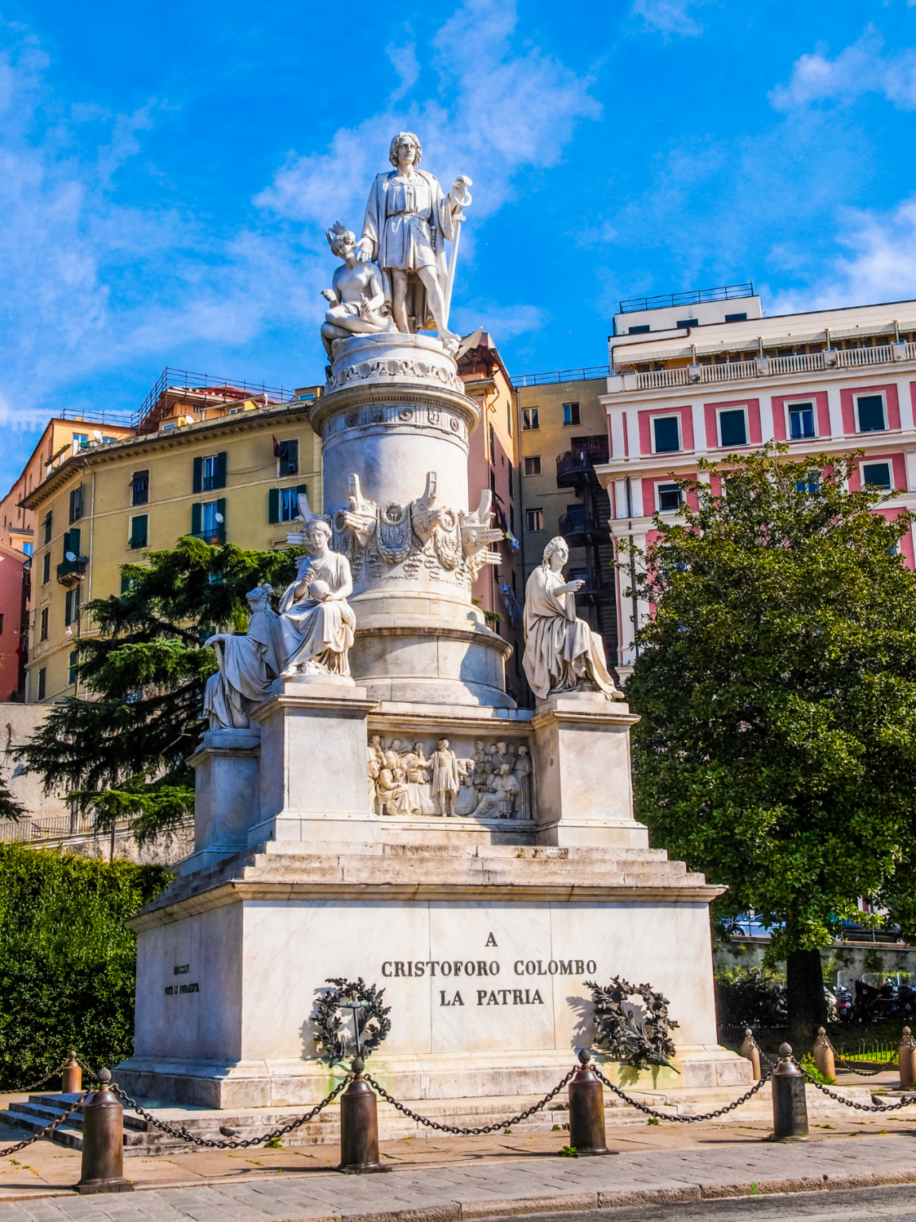
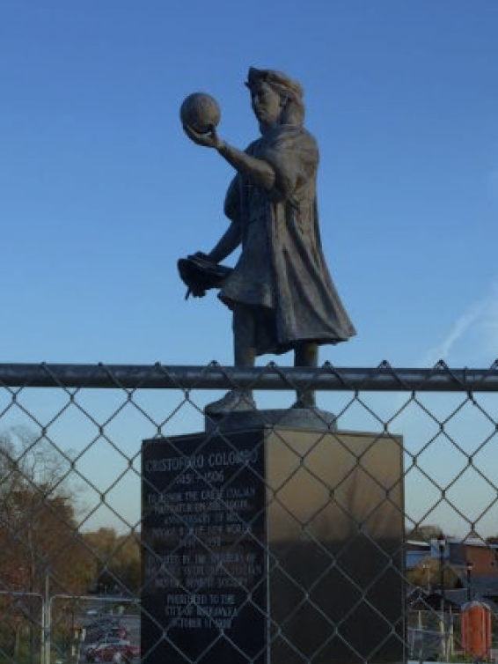
Research value of the collection
Civil rights, race, monuments and memory, health care, nuclear disarmament, city life, women suffrage
Margaret Sanger, Andy Warhol, Dorothy Day, Martin Luther King, Hitler, Pope Francis, Cesar Chavez, Christopher Columbus
Accurate, insightful reporting of Catholic perspective
Notes:
-- Catholics have long been active in shaping the development of US history and society – health care, social welfare, education, and fast forward into the 21st century. While other newspapers cover Catholic leaders, activities and view, the coverage in Catholic newspapers is more extensive, often more detailed in descriptions of events, more authentic in representing the experiences of Catholics, and more accurate in explaining the nuances of Catholic views, all of which complement the research value seen in other newspaper collections.
--The research value of the collection grows with every addition to the digitized content.
--Searching even the current corpus of 17 titles can show change over time in Catholic perspectives from the 1830s up to the 21st century
--We’ve listed some prominent names and themes one can find in the Catholic News Archive, which augment what we find in commercially available newspaper databases. These sources dovetail with other open access projects like the Library of Congress’ Chronicling America.
--Images of Columbus monuments; on left, a European monument, on right, a local Indiana city’s statue, behind fencing while the community considers how to contextualize the monument in these times
--The Catholic News Archive turns up over 2000 references to Christopher Columbus, including stories showing the 1890s Catholic enthusiasm for the founding hero
--There are also stories of Indian schools and missions, and starting in the 1990s, reports of controversy around Columbus commemorations
--With increased attention to Diversity/Equity/Inclusion we will pursue the inclusion of titles documenting the Black Catholic and Native American Catholic experience, such as Daniel Rudd’s American Catholic Tribune, published in Detroit in the 1880s and 90s, and the Catholic Sioux Herald, started in 1892 at a mission school in South Dakota.

Slide 9
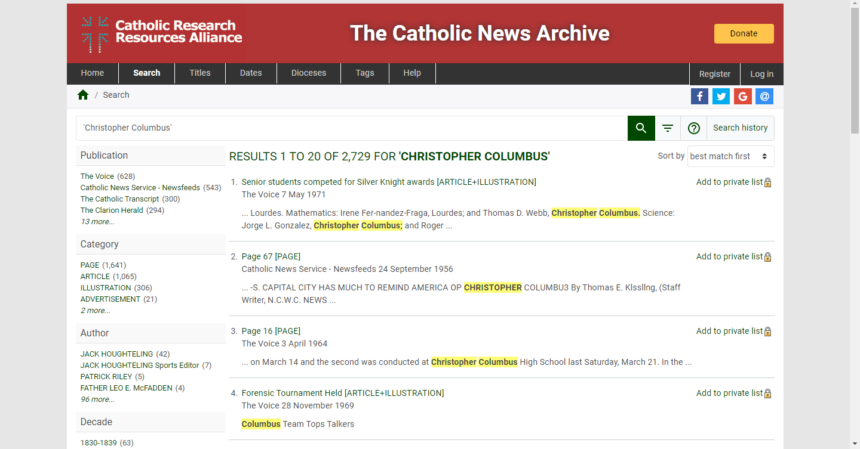
Notes:
--This screenshot of the Catholic News Archive shows results for a search on Christopher Columbus, picking up references as early as 1830 and references to multiple papers.

Slide 10
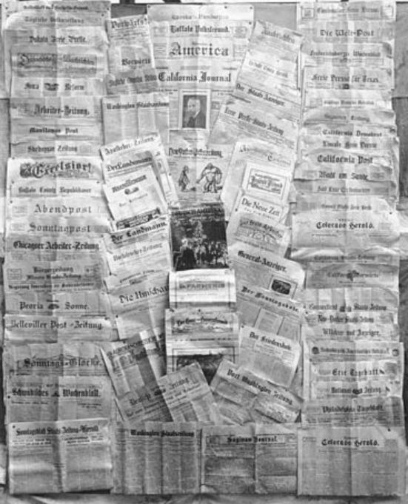
Collection management strategy
Governance by the CRRA community
Digitization
Digital preservation
Access (distributed)
Enhanced value in an aggregated collection
Bottom line: management via a trusted repository
Notes:
--As we note again, the collection is governed by the CRRA community.
--In conversation with scholars, member libraries and archives are able to suggest and prioritize newspapers of local interest, and to support papers of national interest
--Everyone benefits from open access. Digitization and digital preservation proceed with appropriate rights clearance, and adhere to consistent standards of the platform
--From a content holder perspective (the University of Notre Dame), we’re very happy to outsource the digitization and hosting of these newspapers to a trusted repository, with our financial support. We aggregate our Catholic newspaper holdings, so management is easy for member institutions, and access is open to all.
--The image here is of a German-American newsstand, a gesture towards a possible future venture in which we hope to digitize German Catholic papers that flourished into the 20th century. Thus adding to the diversity of content in the Catholic News Archive.

Slide 11
Future direction: Digital Scholarship
Continuing growth in content
Foster new lines of inquiry
Engaging beyond the Catholic network
Text mining/bulk downloading
Develop research guide
Be part of the conversation
https://www.surveymonkey.com/r/CRRA-CNA
Notes:
Before opening up for questions and answers, I’d like to highlight a few of the future directions.
The first, is to continue to improve the Archive so it is as useful as possible to scholars and students. We hope to continue to grow the collections, implement functionality to improve the utility of content for digital humanists and others, and we’re also very interested in engaging beyond the network of Catholic institutions in the US. As Jean indicated there is content in the collection that could be of interest to scholars from any background and
To that end, we do have a survey available for anyone attending this presentation or viewing it afterward for providing input on content that you’d like to see, desired functional enhancements, potential partnerships, and so forth.

Slide 12
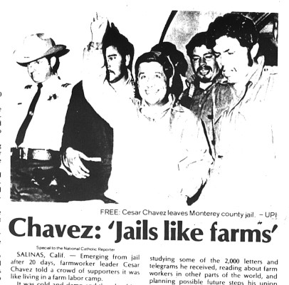
Future direction: Expand Inclusion
Current
Catholic clergy - diocesan newspapers
National Catholic lay papers
Migrant communities - La Esperanza
Socialist - Catholic Worker
Expand underrepresented Catholic voices
Student newspapers
Underrepresented communities - Immigrant, Black Catholic, Native American
From the National Catholic Reporter 8 January 1971.
Notes:
Creating a digital collection Catholic newspapers is the first level of adding diversity to the national landscape of digital newspaper collections. The second level lies in expanding the inclusion of different voices from within the Catholic community. While many of us know of a national paper or two, such as the National Catholic Reporter, or a diocesan paper, we may not be as familiar with papers from migrant or socialist communities. La Esperanza was published by the Claretian Missionaries as a paper from and for the Mexican migrant communities in southern California. Dorothy Day, an influential voice from the left, founded The Catholic Worker in 1933. It is still published today.
Our attention is turning also to student college newspapers, to past German, Italian, Irish, and more, immigrant community papers, and to Black papers from Black Catholic communities, which were often centered in a single parish church. The first paper by Black Catholics was in Detroit, started in the 1880s-1890s. The Catholic Sioux Herald was also published in the late 19th century.

Slide 13
Thank you for joining us!
SURVEY: https://www.surveymonkey.com/r/CRRA-CNA
Paul Bracke bracke@gonzaga.edu
Jean McManus Jean.C.McManus.15@nd.edu
Jennifer Younger jyounger@catholicresearch.org

